Slide 1
DISARM Milestone One
Matthew Intriago
Client: Dr.Wilde • Advisor: Dr.Silaghi • 8/30/2020

Slide 2
Project Members
CSE Team
AEE Team
AEE Team
Matthew Intriago
Control Subsystem Supporting Engineers
Nouraldean El-Chariti
Mike Leard
Daniel Soto
Project Manager
Kyle Watkins
Project Systems Engineer
Luca Rizza
Electronics
Mike Leard
Ali Lebbar
Davey Reinoid
Grappling Mechanism
Daniel Soto
Laura Guziczek
Structures
Vincent Panicelli

Slide 3
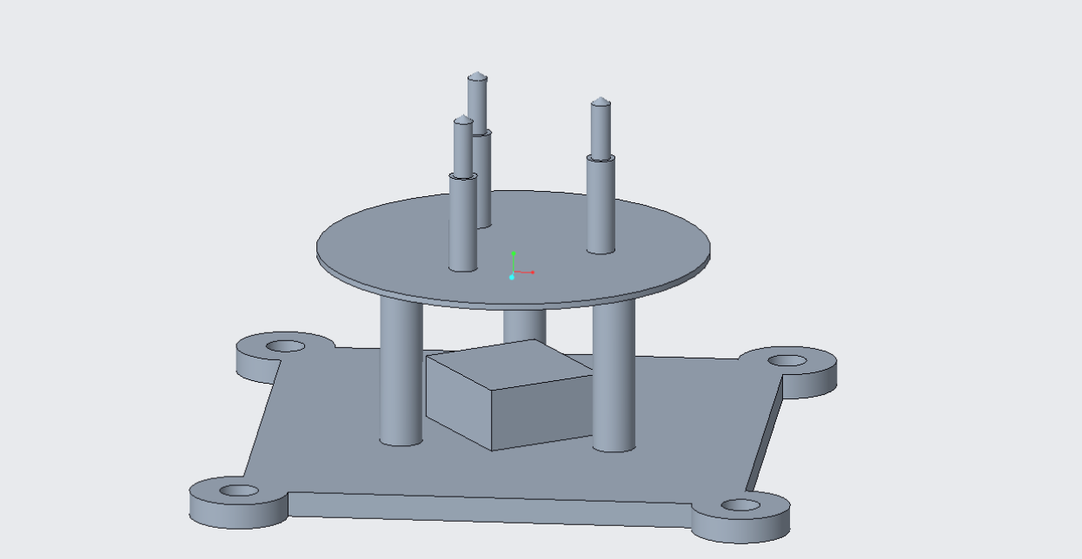
Requirements
Divided into three sections
Grappling Device Autonomy
Grappling Device Manual Function
Grappling Device Simulation
Requirement | Description
CNSY-09 | The simulation shall demonstrate all the forces and stresses acting on the welding system.
CNSY-10 | The simulation shall display the algorithm’s ability to adapt to different debris.
CNSY-11 | The simulation shall demonstrate the weld in action and the thermal changes on the system.
Concept Model

Slide 4


Test Plan
Test cases are similar throughout the requirements
Algorithm will be tested using two debris sized models
Example:
CNSY-10 The simulation shall display the algorithm’s ability to adapt to different debris
TEST CASE 1 | TEST CASE 2
Demonstrate algorithms ability to seam track a 27 cubesat unit debris. | Demonstrate algorithms ability to seam track a specific 10 unit cubesat debris surrounded by other orbited debris.

Slide 5
Design
Developed a UML Diagram for algorithm control
DISARM system will consist of a simple interface where users will have access to the manual features of the project

Slide 6
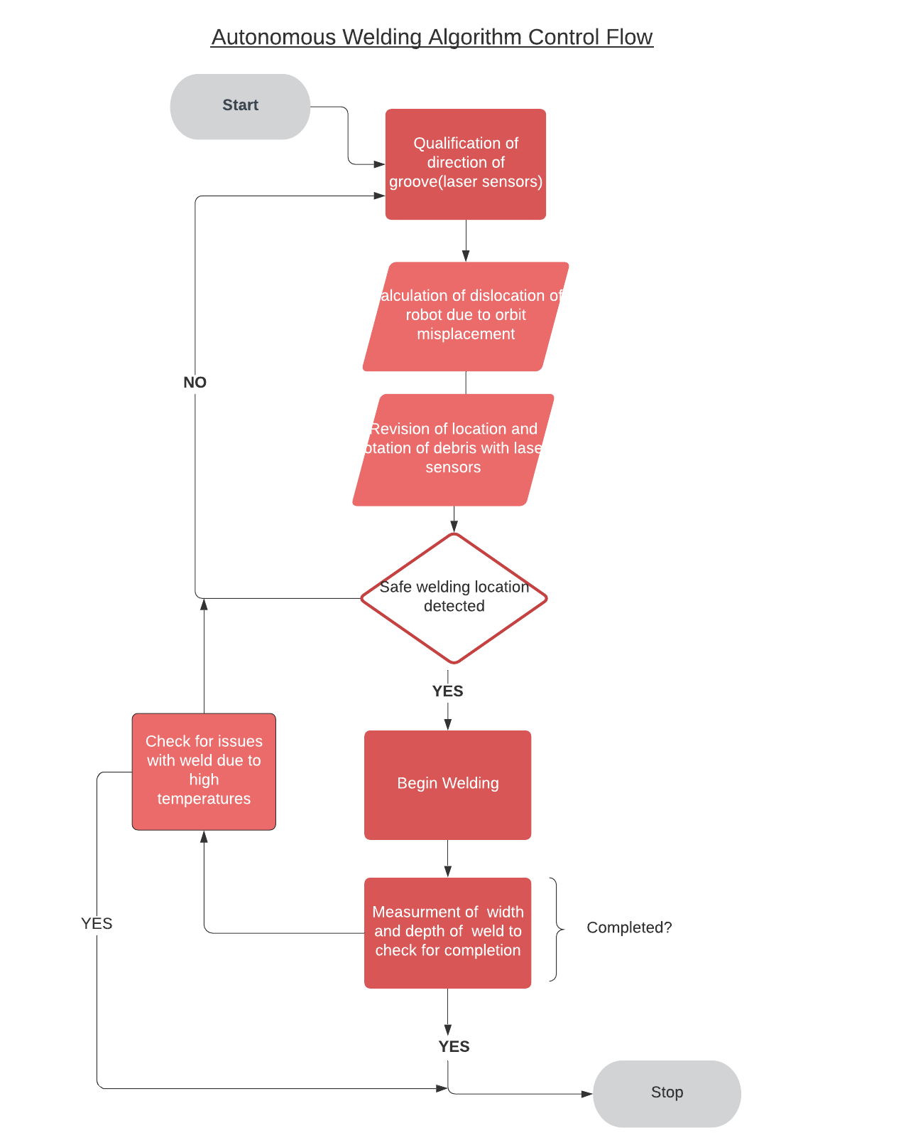
Figure 2: UML Diagram of Algorithm Control Flow

Slide 7
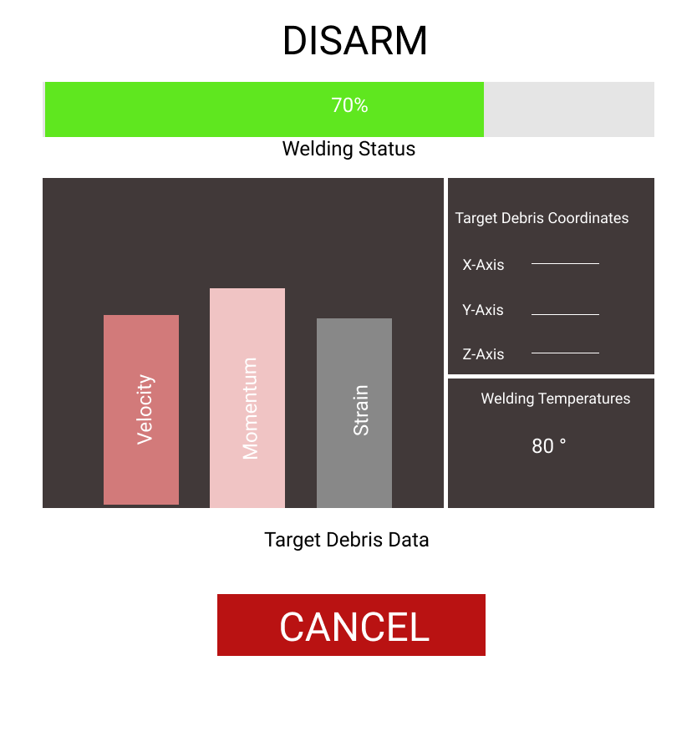
Figure 3: Mock-Up Interface

Slide 8
Milestone Two Steps
1) Design algorithm pseudocode
2) Produce a draft of the algorithm
3) Develop Gazebo models for 27 cubesat unit and 10 cubesat unit debris.

Slide 9
Thank you.
Matthew Intriago
Client: Dr.Wilde • Advisor: Dr.Silaghi • 8/30/2020

